Slide 1
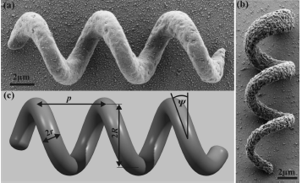
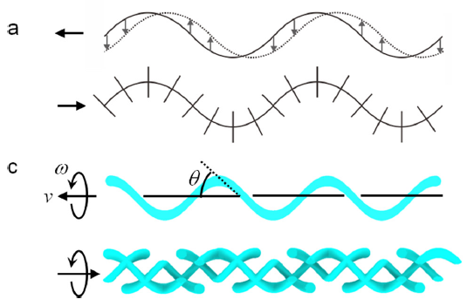
Helical Micro robot Navigation (Literature Review)
Fabrication method
3D lithography
Electromagnetic
beam evaporation
Locomotion method
Analysis of flagellum structure and locomotion

